Slide 1


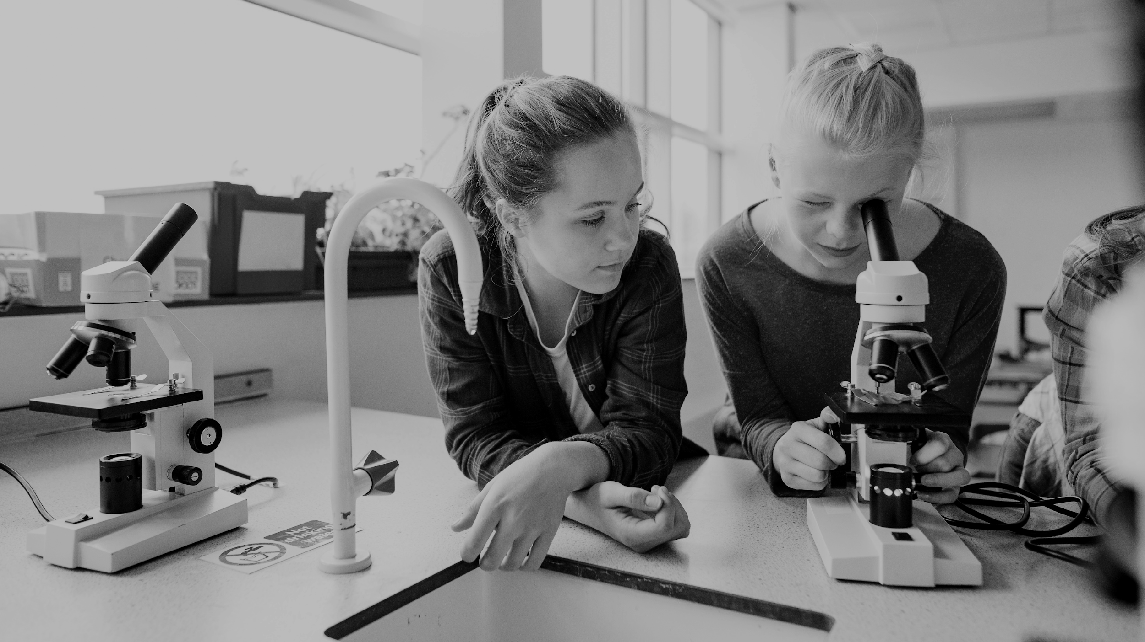

2024-2025
ADVANCED LEARNING ACADEMY
ADVISORY BOARD MEETING
March 12, 2025
Presentation by:
Amy Scruton
Principal

Slide 2
HISTORY
 | 2020-2021*** | 2021-2022 | 2022-2023 | 2023-2024 | 2024-2025 | 2025-2026 projections
Grades | 3rd-12th | 3rd-12th | K-12th | TK-12 | TK-12 | TK-12
Elementary | 51 | 36 | 59 | 87 | 107 | 121
Intermediate | 179 | 173 | 117 | 112 | 111 | 114
High School | 114 | 179 | 152 | 157 | 149 | 149
Total Enrollment | 344 | 388 | 328 | 356 | 367 | 384
Teachers | 21 | 23 | 25 | 25 | 25 | 23
Location | 1st Street (9-12) 4th Street (3-8) Circulos Grant-4 | Hoover (3-8) Walker (9-12) Circulos Grant-5 | Santa Clara Site (K-8) Bishop (9-12) | Santa Clara Site (TK-8) Bishop (9-12) | Santa Clara Site (TK-8) Bishop (9-12) | Santa Clara Site (TK-8) Bishop (9-12)
*** Distance Learning

Slide 3
Current Advisory Board Officers
Diana Torres- Board President
Alicia Skibby- Vice President
Gloria Lira- Member
Cheryl Whittington- Member
Bryan Davis- Member

Slide 4
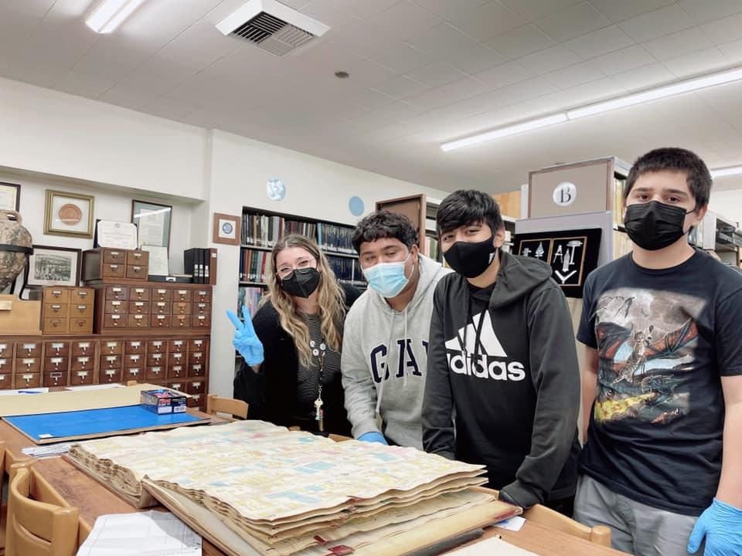

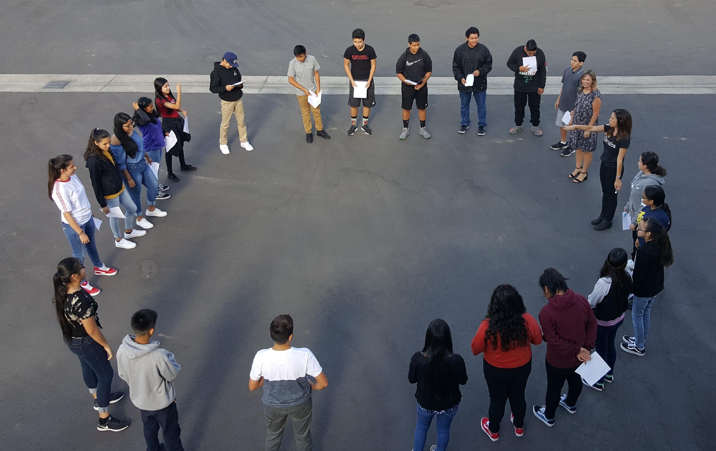
REVENUES:
LCFF Sources
Federal Revenue
Other State Revenue
Other Local Revenue
Total Reserves

Slide 5
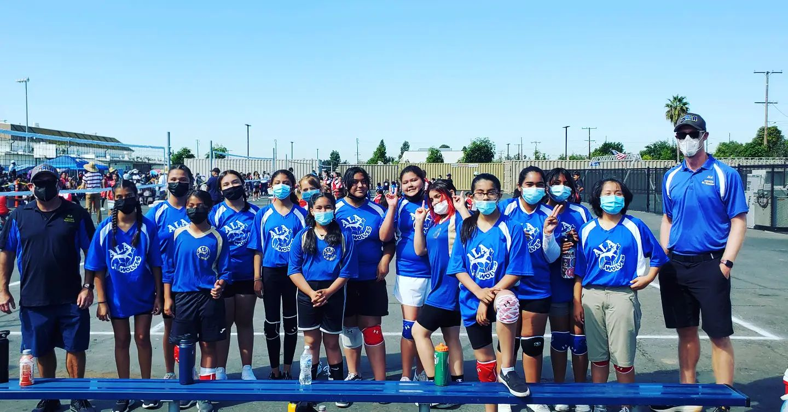
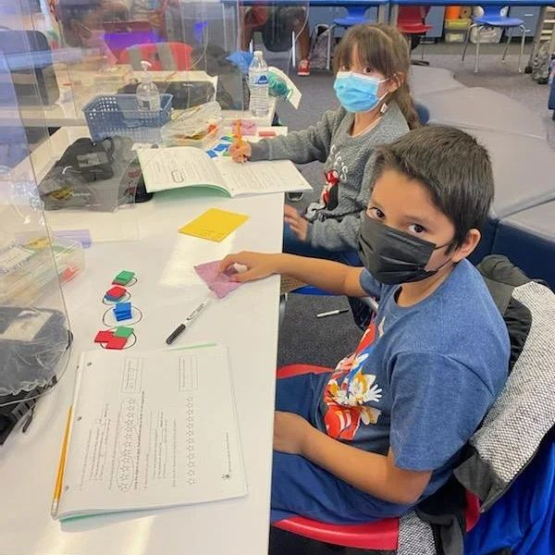
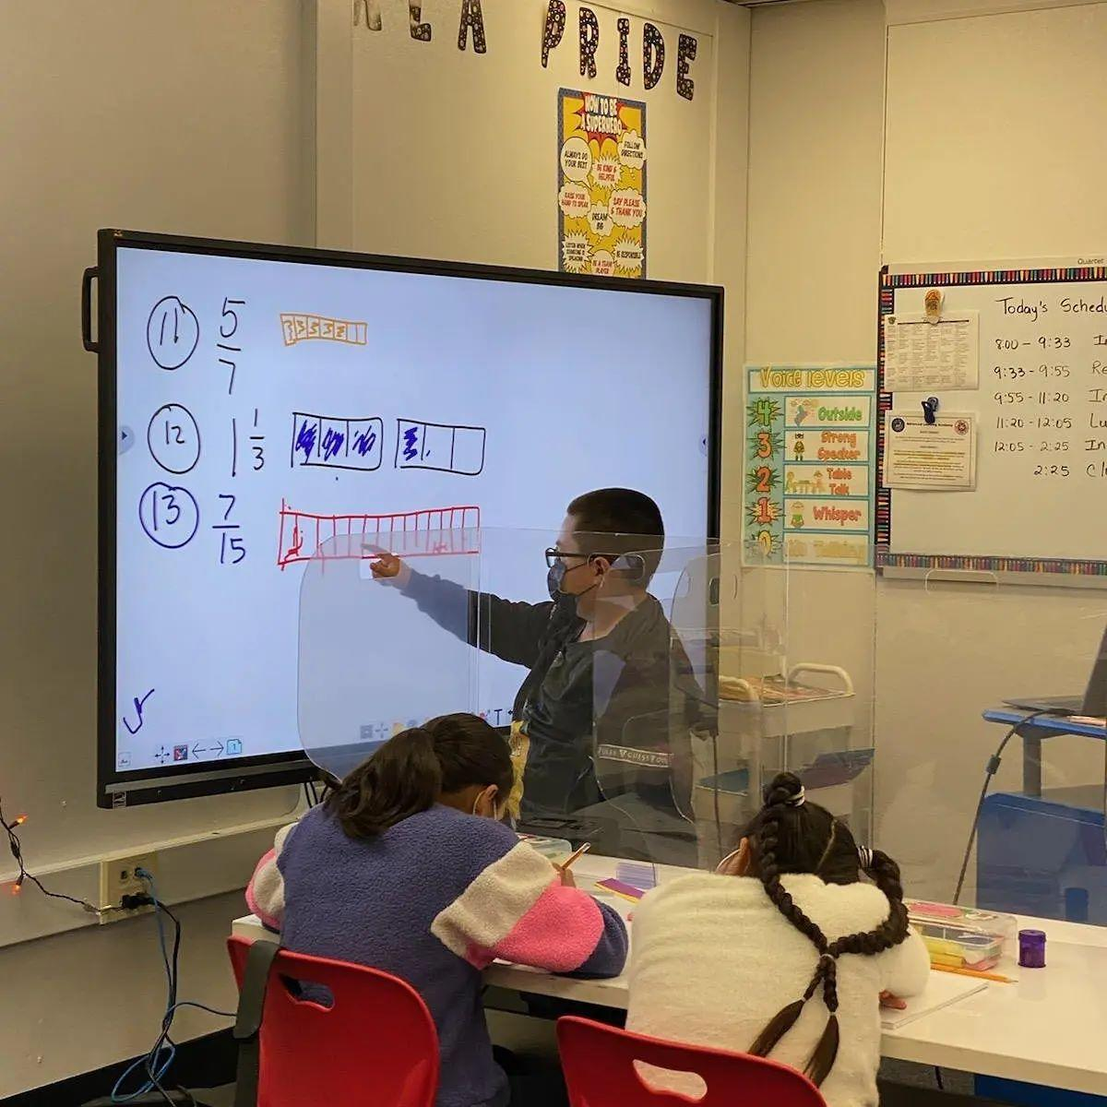
EXPENDITURES
Certificated Salaries
Classified Salaries
Employee Benefits
Books and Supplies
Other Outgo

Slide 6
COMPARABILITY
Charter Fund Revenue | Approved Budget | Unaudited Actuals | Variance | Explanation
LCFF Resources | $5.394 M | $2.006 M | $0 | No adjustments made at second interim
Federal Revenue | $63,055 | $0 | $21,897 | Increase due to final 24/25 Title 1 adjustments
Other State Revenue | $920,212 | $321,954 | $27,585 | increase to match Prelim Arts and Music in schools entitlement
Other Local Revenue | $80,000 | $57,937 | $45,000 | Increase due to unearned revenue (carryover) for Circulos grant allowed to keep by grantor
Total | $6.457M | $2.385 M | $57, 243

Slide 7
COMPARABILITY
Charter Fund Expenses | Approved Budget | Unaudited Actuals | Variance | Explanation
Certificated Salaries | $4.508 M | $2.390M | $62,591 | Decrease due to 2nd interim salary adjustments
Classified Salaries | $904,119 | $392,577 | $19,799 | Decrease due to 096010 Adjustment to excess budgeted for vacancies goal 1287
Employee Benefits | $2.311 M | $1.091 | $35,430 | Decrease due to the salary adjustment in associated salaries.
Books and Supplies | $224,644 | $28,125 | ($49,546) | Increase due to reallocating 013010 ConAPP revision 100% award allocation for 2024-2025for ALA 093010. 063010 Adjustment to excess budgeted for vacancies goal 1287.
Services and other Operating Expenses | $363,184 | $71,029 | ($349) | Increase due to 092600 transfer needed for new program at Circulos
Other Outgo - Transfer of Indirect Costs | $462,040 | $3,281 | $5,094 | Decrease due to indirect cost adjustment
Total |  |  | $73,018

